Slide 1
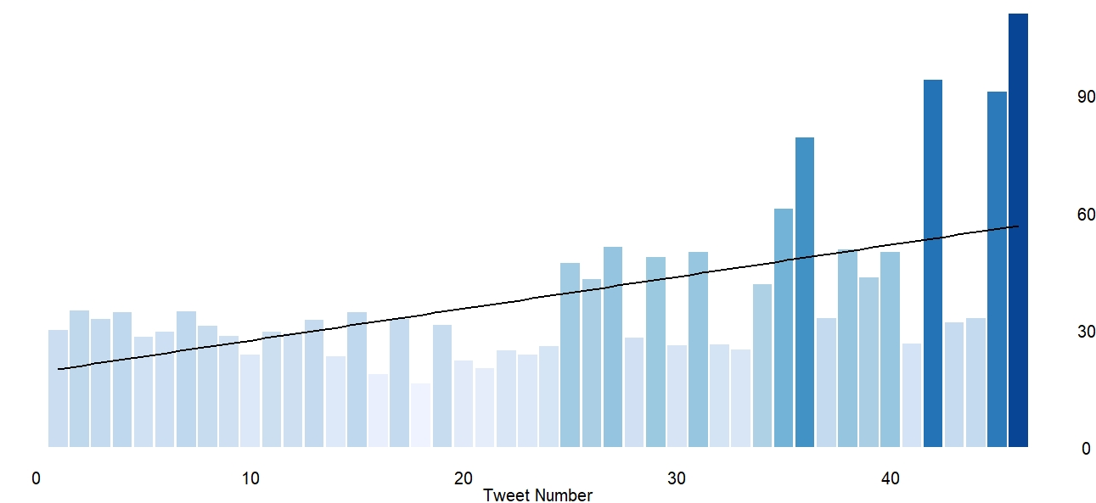

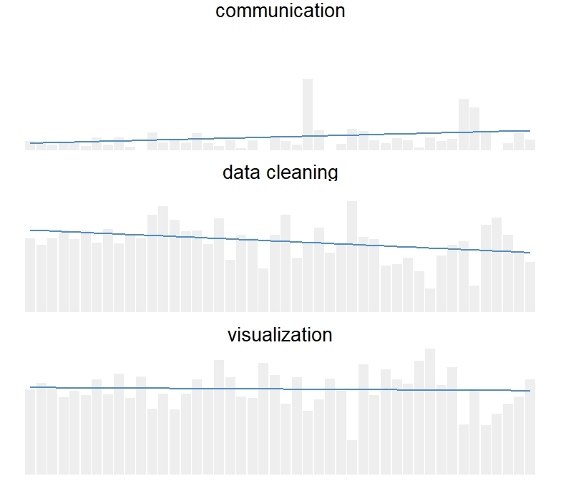
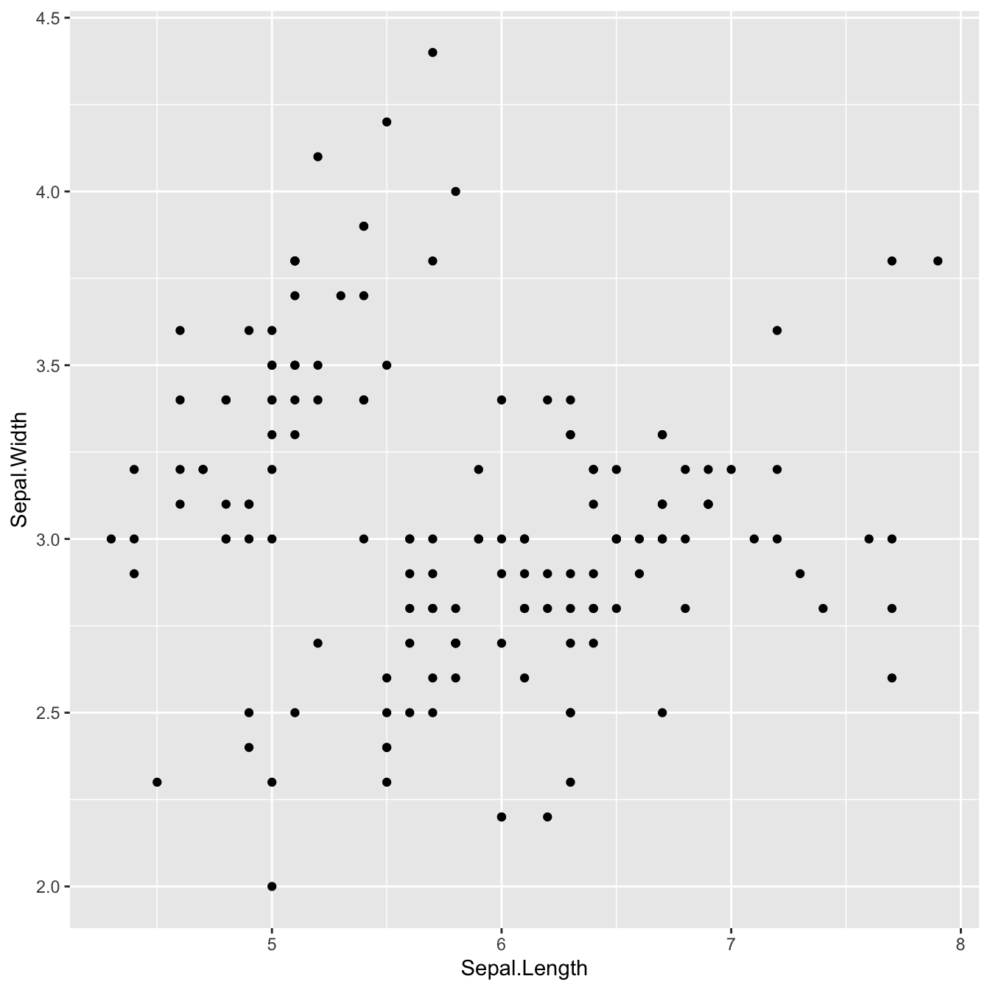
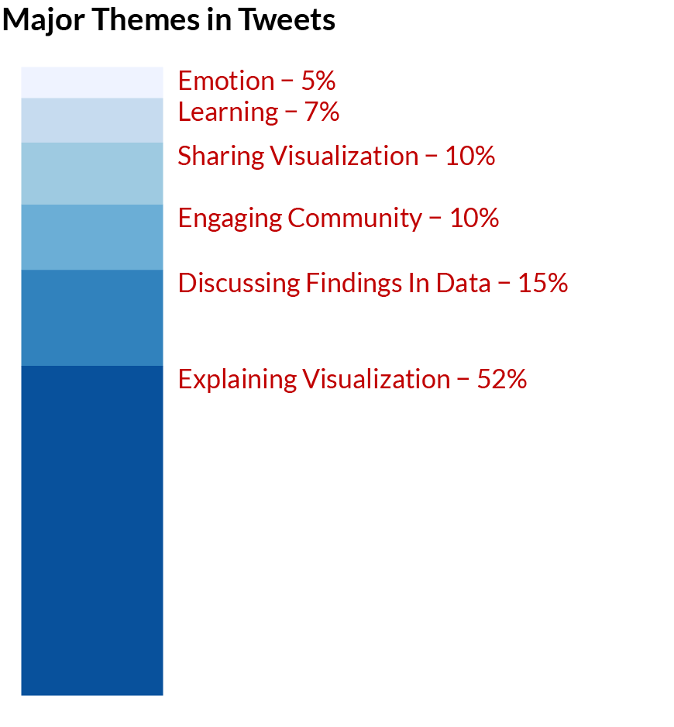
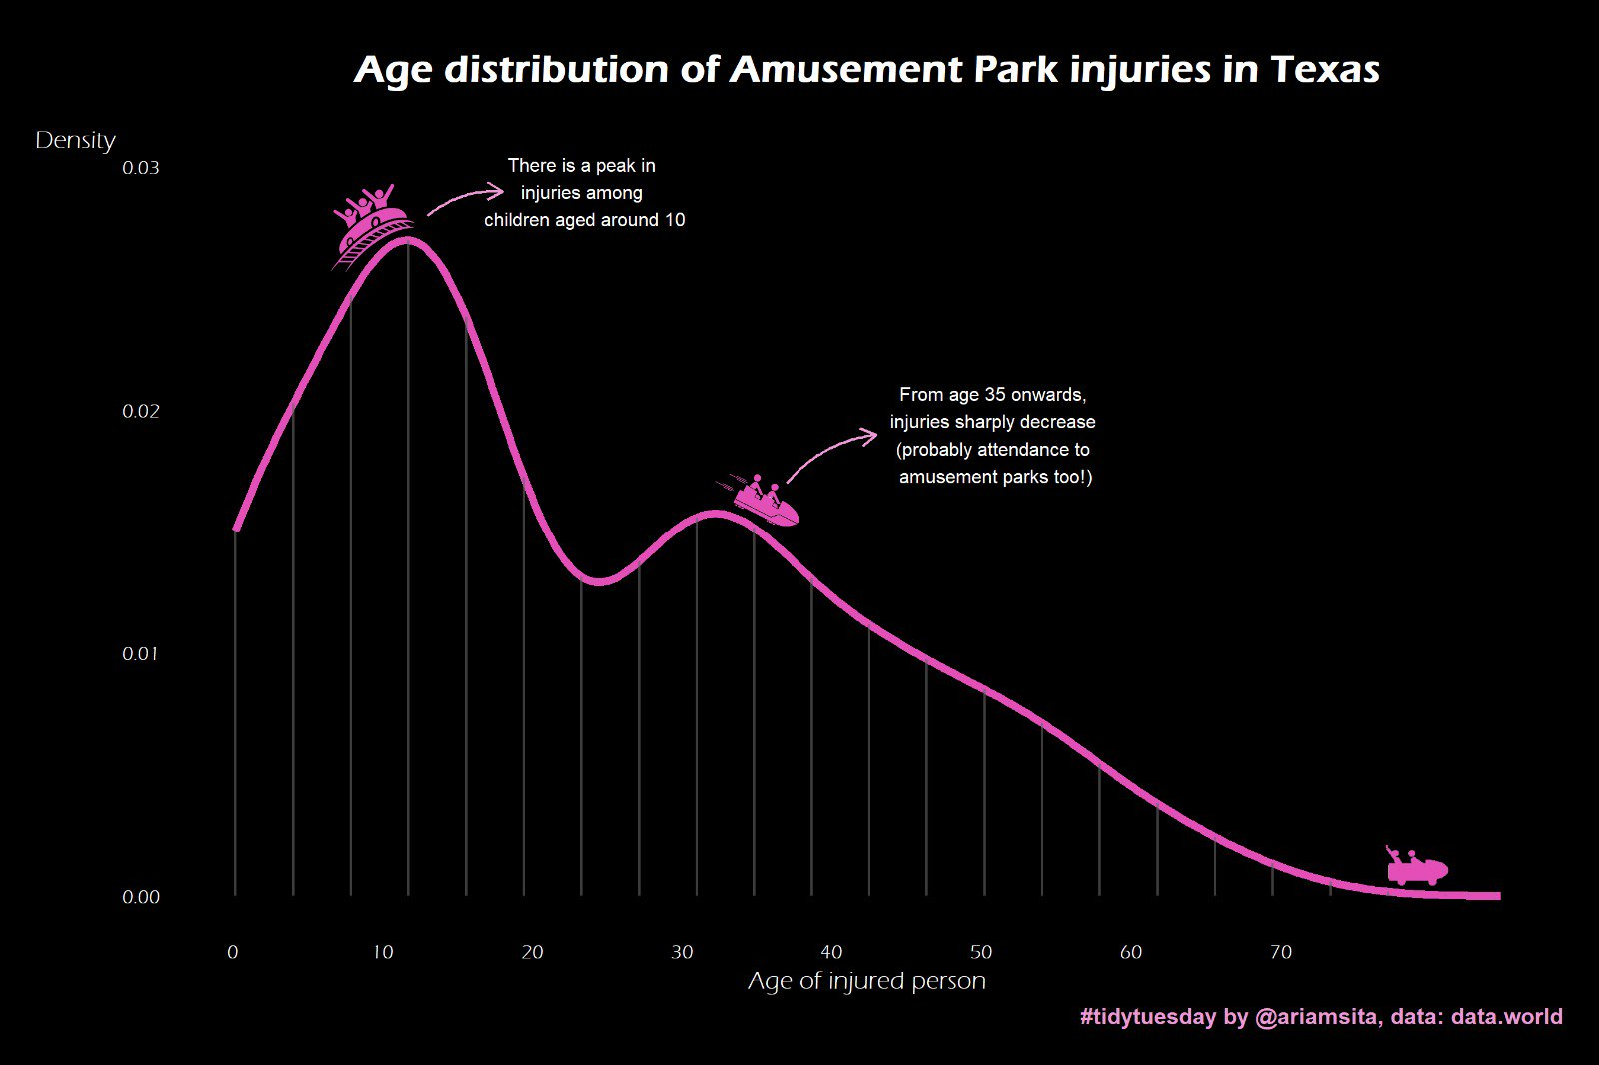
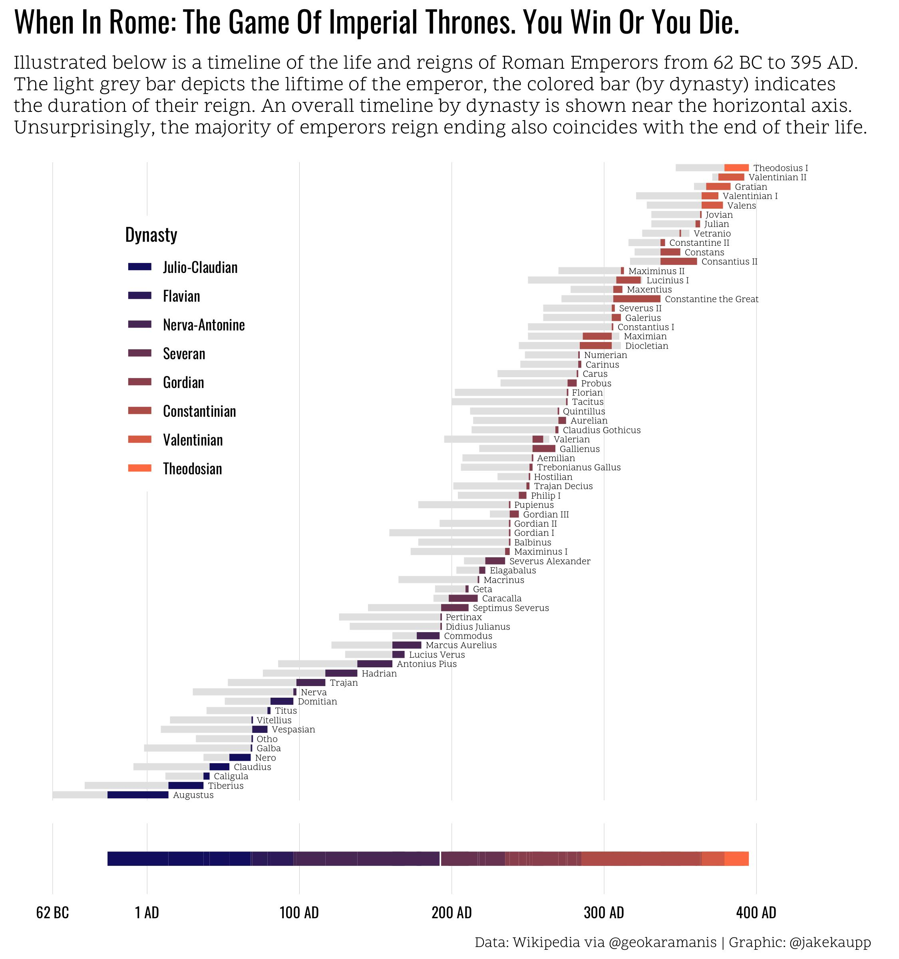
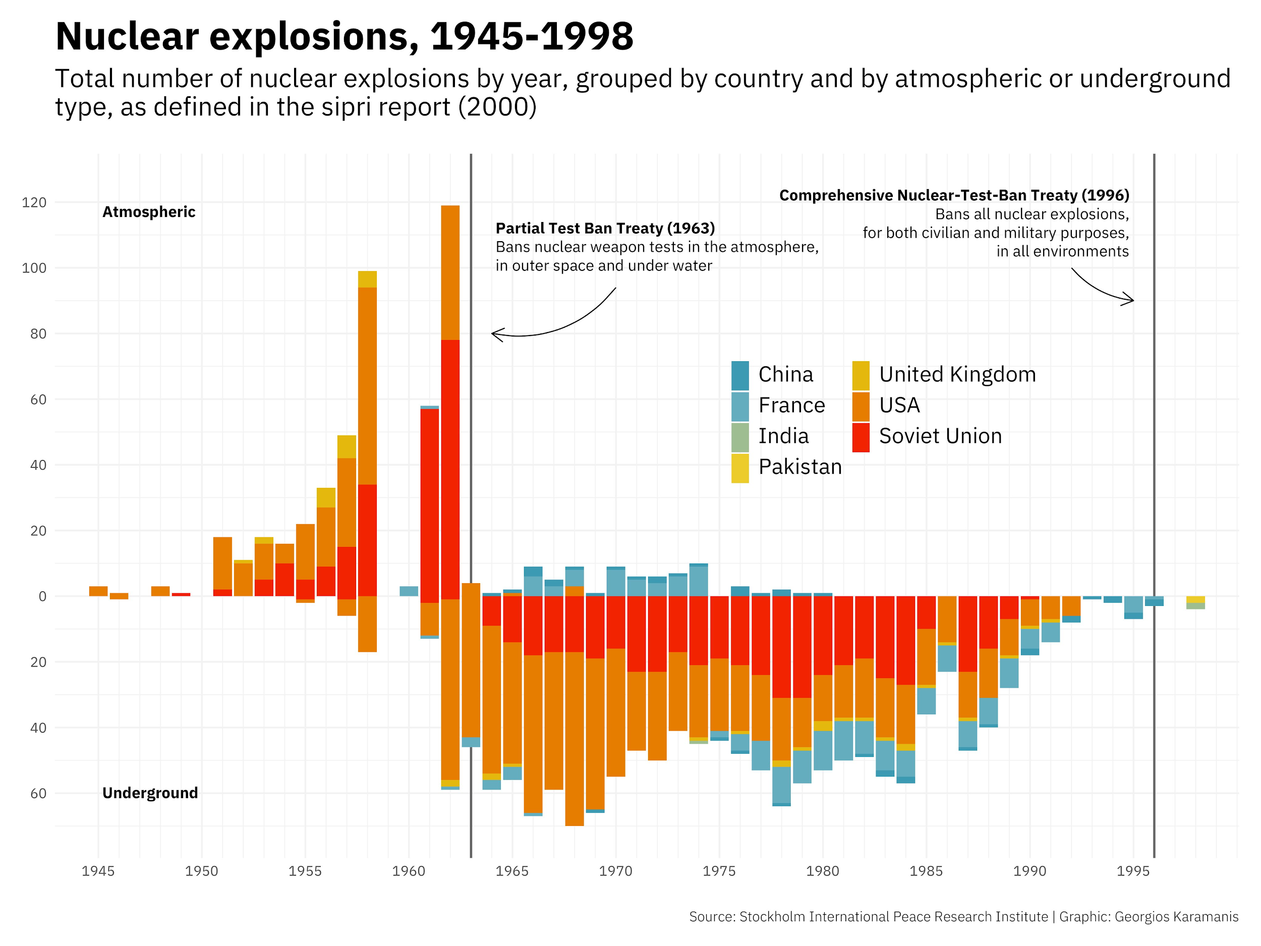
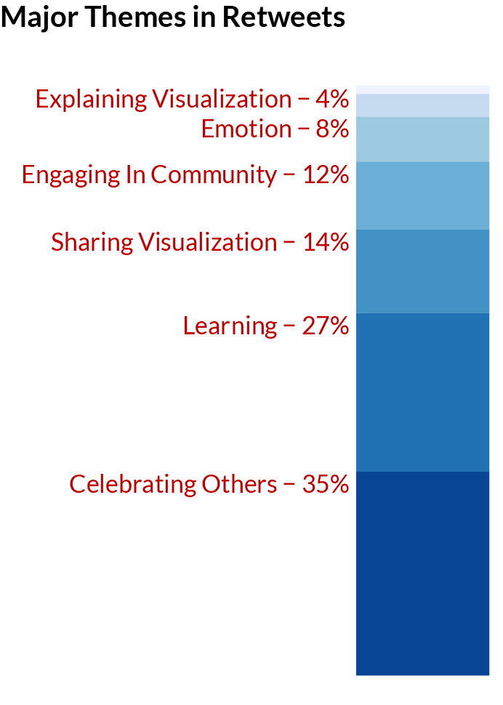
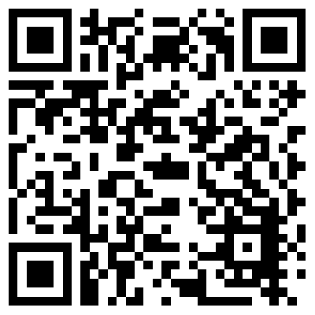


Becoming “TidyR” over Time: Data Visualization Development in an Online Community of Practice
Content Analysis
Over time, contributors write longer code and use more functions.
This suggests their code may become more sophisticated over time.
Data visualization skills can be developed by participating in the #TidyTuesday Twitter-based community .
Average Number of Functions over Time
r = .54, p <.001
PRESENTER:
Anthony Schmidt
Evaluation, Statistics, and Measurement
aschmi11@utk.edu / anthonyschmidt.co
AUTHORS
Schmidt, Anthony (ESM)
Rosenberg, Joshua (TPTE)
Communication
Functions related to communication are increasing.
Annotations and a focus on textual elements increasingly become important.
Communities of Practice
Groups of people who share a common interest and participate in activities that promote domain-specific learning.
#TidyTuesday
The #TidyTuesday hashtag is a community of practice for those interested in data visualization and data science.
Every Tuesday, a unique dataset is posted on Twitter using the hashtag #TidyTuesday.
Participants use the dataset to create visualizations using the R programing language
Participants then share their visualizations on Twitter and link to their code (on Github).
R
R is a statistical programming language that is used for data analysis, modeling, machine learning, and visualization.
Research Purpose
Understand how #TidyTuesday serves as an online community of practice.
Determine if participation in #TidyTuesday can foster data visualization skill development.
Data / Methods
Data: One year of #TidyTuesday tweets from tidytuesday.rocks app
Descriptive analytics (frequencies, means, correlations)
Qualitative thematic coding
Content analysis of code contributions (using TidyCode)
geom_label(), geom_curve(), str_wrap(), arrow()
Data Cleaning/Wrangling
Data cleaning, wrangling, and munging functions decrease.
This suggest less processing of data or using more efficient code.
mutate(), filter(), case_when()
Data Visualization
Functions related to visualization remain mostly constant.
This suggests visualizations remain the primary focus of coding.
theme(), geom_path(), aes(), facet_wrap()
Qualitative Analyses
library(ggplot2)
iris %>%
ggplot() +
geom_point(aes
(x=Sepal.Length,
y=Sepal.Width))
First ever #TidyTuesday submission! I've always been reluctant to share, because I see so many great submissions. But today I've done some new cool things (first time I made a map in R!!) and I'm quite happy with the result.
My #tidytuesday viz this week is inspired by awesome people who make scarves from data. Can't knit, but I can geom_linerange
#tidytuesday I used to think all nobel peace price winners are grey old guys. Turns out, they are getting younger compared to the other folks.
#TidyTuesday turned into tidy Saturday this week! Looking at plastic pollution around the globe. I made a waffle chart of the five countries with most mismanaged plastic waste.
#TidyTuesday Examples
N = 150
Descriptives
Findings
Code becomes longer, using more functions, over time.
Visualization functions remain constant.
Data wrangling functions decrease.
Communication functions have increased.
Initial tweets explain visualizations, describe findings, or engage the community.
Retweets celebrate others’ work, discuss learning, or share others’ visualizations and resources.
Conclusion: Participation can help develop and improve visualization skills.
This thread highlights one of my favorite parts of #TidyTuesday, spontaneous and friendly collaboration!! Sara continues to do awesome deep dives on the #tidytuesday datasets! Lots of great content here and on her GitHub.
Thanks to #TidyTuesday for making it so easy to learn/use #R and to get to know others! #grateful
Jake's dataviz work as part of #TidyTuesday is always beautiful. This one is especially great. Check out the legend he made using ggplot.
4,418
2,428
800
46.7
5.93
.95
Total number of Tweets
Unique contributions
@ariamsita
@jakekaupp
@geokaramanis
Unique contributors
Mean contributions per week
Mean contributions per user
N = 150
Correlation between likes and retweets
Take a picture to download the poster and short paper

